Slide 1
GridAI: Front-end Team
Lightning Talk 8: Ethics and Professional Responsibility
Team ID: SD May 25-43
Client: Dr. Gelli Ravikumar
Skyler Kutsch Rangsimun Bargman Franck Biyoghe Bi Ndoutoume Jesus Soto Gonzalez Hang Thang Justin Soberano B.

Slide 2
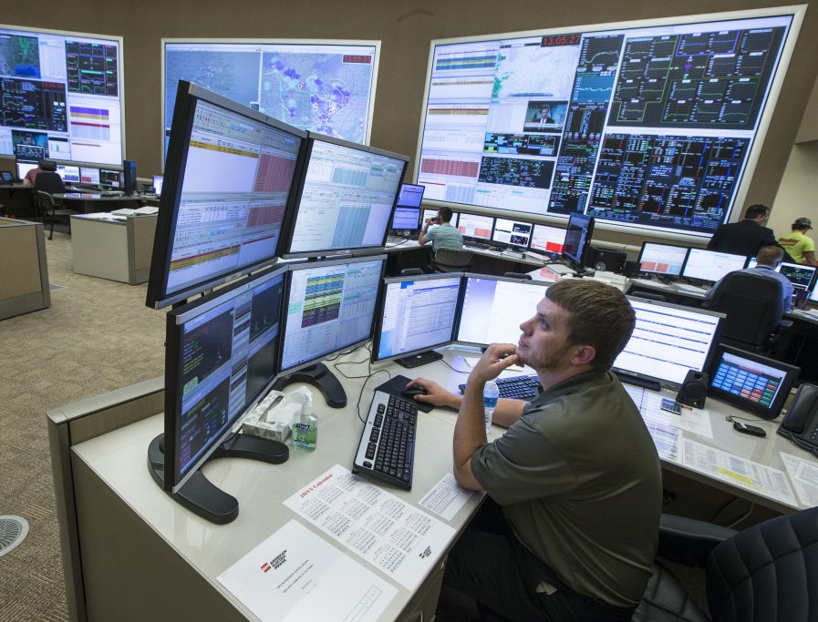
Project Overview
Objective: Develop an intuitive, responsive front-end interface for GridAI using React, facilitating seamless backend interaction and enhancing user experience.
Scope: Support power utility operators and energy producers in managing grid operations efficiently with AI-driven tools.
Goals: Prioritize the user experience, accessibility, performance optimization, and maintainability of the web application.

Slide 3
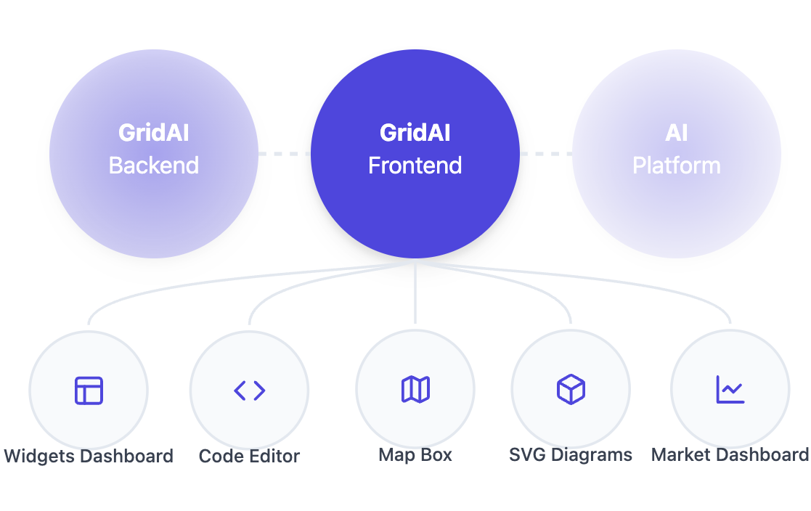
What is GridAI?
GridAI is an advance electric power grid management platform designed to:
Simplify Complex Data Management.
Offer Customizable Real-Time Data Visualizations.
Ensure High Performance and Scalability.
Integrate AI-Driven Tools.

Slide 4
IDEALS Professional Responsibility – Performing Well
Area: Honest Communication
Relevance: Effective and honest communication ensures that the client is fully informed about project progress, fosters trust, and allows for timely feedback. For GridAI, its complexity demands precise coordination among team members and with the client.
Approach:
Weekly updates
Code Accessibility
Client Feedback
Why It’s Ethical:
Builds trust and maintains professional integrity by keeping the client informed.
Ensures alignment between the team’s efforts and the client expectations.
Promotes accountability and collaboration within the team and client.
Notes:
An area where we are performing well in is in Honest Communication Having effective and honest communication makes sure that the client is fully informed about project progress, fosters trust, and allows for timely feedback. GridAI, demands precise coordination among team members and with the client. Our approach for this is having weekly standups with the client to show what we have done so far, making our code accessible and always pushed and merged onto the development branch for testing as well as incorporating feedback and adjusting our implementations. Having honest communication builds trust and maintains professional integrity, it makes sure that the whole team is aligned and meets client expectations, while also promoting accountability and collaboration.

Slide 5
IDEALS Professional Responsibility – Needs Improvement
Area: Addressing Scope Creep
Relevance: Delivering a polished, efficient, and error-free front-end is critical to achieving GridAI’s objectives and ensuring a high-quality user experience. However, scope creep has expanded the project’s requirements beyond the original plan, making it challenging to meet deadlines without compromising on quality.
Current Scope Issues:
The project originally focused on three main areas but has expanded to encompass five areas and backend code.
Prioritizing deadlines and deliverables over code robustness and efficiency.
Improvement Plan:
Dedicate time specifically for testing, debugging, and peer code reviews to maintain quality.
Conduct regular scope reviews to ensure that future changes are carefully evaluated and their impact on deadlines and resources is clearly understood.
Notes:
An area where we are improving upon is addressing and adjusting to Scope Creep. Delivering a polished, efficient, and error-free front end is critical to GridAI’s objectives and to also deliver a high-quality user experience. However our projects requirements have expanded beyond the original plan, making it challenging to meet deadlines without compromising on quality. Some of the current issues include, our projects’ scope expanding to encompass five areas and backend code, where originally it was only 3 areas. And prioritizing deadlines and deliverables over code robustness and efficiency
So in order to address this, we have dedicated time specifically for testing, debugging, and peer code reviews to maintain quality. We have also conducted regular scope reviews to make sure that any future changes are carefully evaluate and their impact on deadlines are clearly understood by the client.

Slide 6
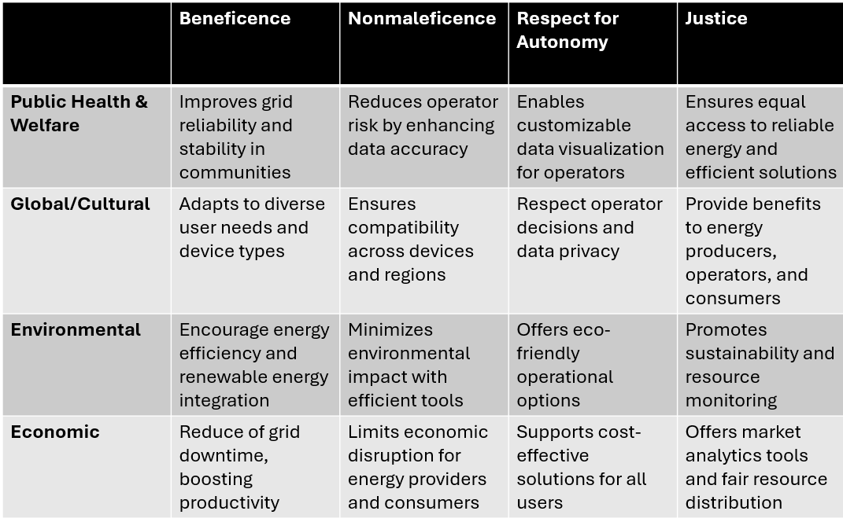
Broader Context Area-Four Principles Chart

Slide 7
Highlight – Public Health, Safety, and Welfare
Relevance:
Enhancing grid reliability directly impacts public safety by preventing outages.
Contributes to the well-being of communities by ensuring consistent access to electricity.
Ethical Concern:
Risk of unauthorized access, misuse, or branches of sensitive operational data that could compromise system security and user privacy.
Improvement Plan:
Implement advance security measures
Conduct regular security checks
Role-Based Access Control
User Education
Notes:
Relevance: Being able to accurately predict outages and overuse is crucial for providing accurate warning to affected communities
Since, this is communicated through the frontend, we have to make sure that it robustly provides this information.
Ethical Concern: Any unauthorized access at an administrative level could possibly suppress these warnings
Improvement Plan: Ensure proper security mechanisms are being followed (access log monitoring, role-based access control, and user education)

Slide 8
Ethical Concern
Ensuring equitable access to GridAI’s features and functionality for users with varying levels of technical expertise and access to resources.
Plan to Address:
Simplified user interface that accommodates users with different technical skills.
Provide clear comprehensive documentation and tutorials for diverse user groups.
Tailored role-based access control features to reduce complexity and task efficiency.
Conduct inclusive user testing with users from various demographics and roles.
Notes:
GridAI is designed to be used by users of varying level of technical expertise (customers, operators, maintainers)
To address this:
The UI needs to be simple enough for customers to understand but also offer more complexed versions for operators and maintainers
Provide documentation on how to use the UI and tutorials to cover basic operation
Conduct comprehensive user testing at various skill levels to ensure that the UI has an intuitive workflow

Slide 9
Virtue Highlight – Commitment to Quality
Importance: Commitment to quality ensures that GridAI delivers a reliable, user-friendly, and high-performing product. This virtue will drive the team to uphold professional standards and meet expectations of clients and end-users.
Will be demonstrated by:
Prioritizing user experience by designing an intuitive and efficient interface.
Ensuring consistency and maintainability across all code and components.
Rigorous testing to identify and address potential issues early.
Future Steps:
Strict collaborative review of design and functionality based on client feedback.
Foster a culture of continuous improvement within the team to maintain high standards.
Integrate automated testing to enhance reliability and reduce errors.

Slide 10
Conclusion
In this lightning talk we:
Highlighted how GridAI upholds ethical and professional principles, from fostering transparent communication to addressing challenges like ensuring data security and adhering to high engineering standards ensures that reliability, efficiency, and integrity in the results.
Showcased our commitment to quality, ensuring that GridAI not only achieves technical goals but also serves users effectively and responsibly.
Moving forward, we will continue to prioritize collaboration, adaptability, and innovation to deliver a product that empowers users and benefits communities.
Notes:
Everything in our work project involved Ethical and professional principles.
sharing of information, each other, Ensures everyone understands goals, challenges, and progress.
From technical views, make sure users’ can navigate to everything without having any difficulty.
Second, sure make sure users data safe which is accessibility.

