Slide 1
GridAI
Lightning Talk 6: Contextualization / Design Check-In
Skyler Kutsch Rangsimun Bargman Franck Biyoghe Bi Ndoutoume Jesus Soto Gonzalez Hang Thang Justin Soberano B.

Slide 2
Project Overview
We are developing an AI integrated system to help grid operators and energy producers manage the complex electrical grid more efficiently. This tool will address challenges in handling large datasets and optimizing grid operations through intuitive interfaces and predictive analytics.
Key features of the system include real-time data visualization, predictive fault detection, and automated decision-making support.
The system addresses significant challenges, such as the ability to handle large datasets efficiently and ensuring the reliability and scalability of grid operations.

Slide 3
Current Design
The current design implements:
Modular React component architecture
Real-time WebSocket data streaming
Drag-and-drop widget customization
Role-based access control
Integration with Firebase backend

Slide 4
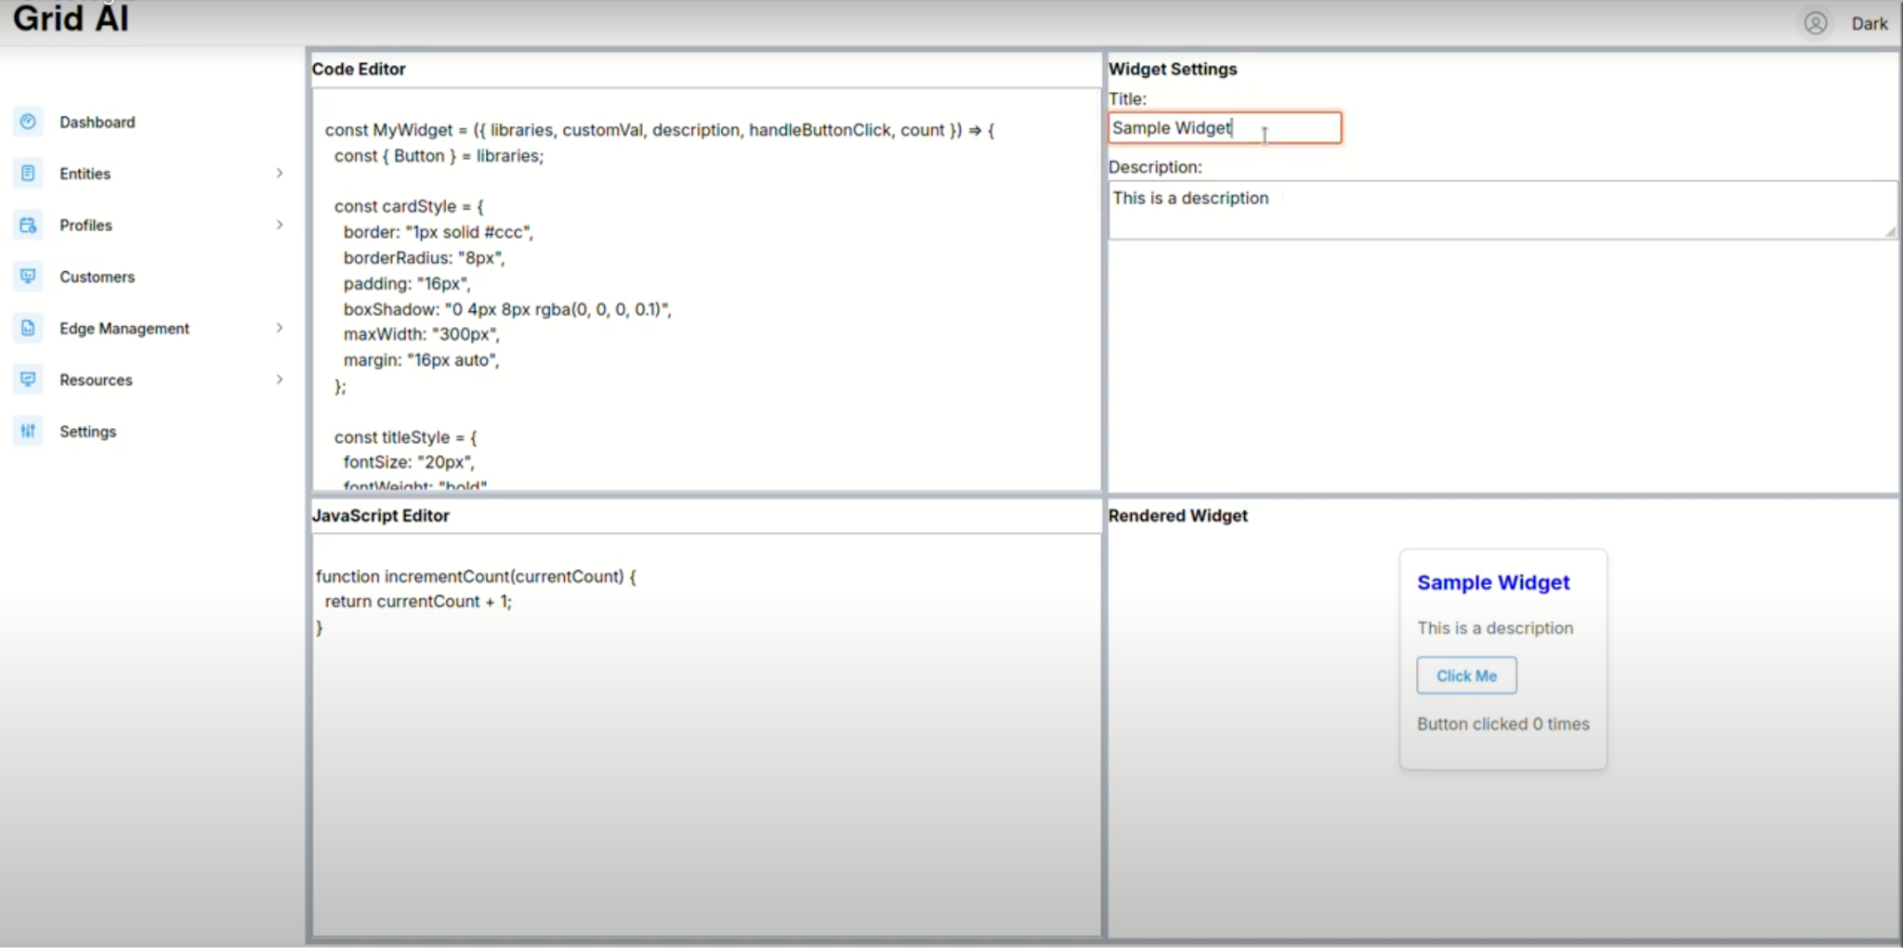
Current Designs
Current Design of Widgets Dashboard

Slide 5
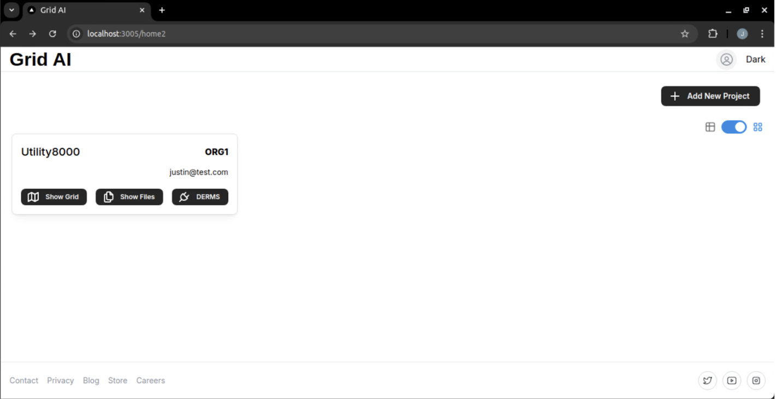
Current Designs
Current Design of Project Selector

Slide 6
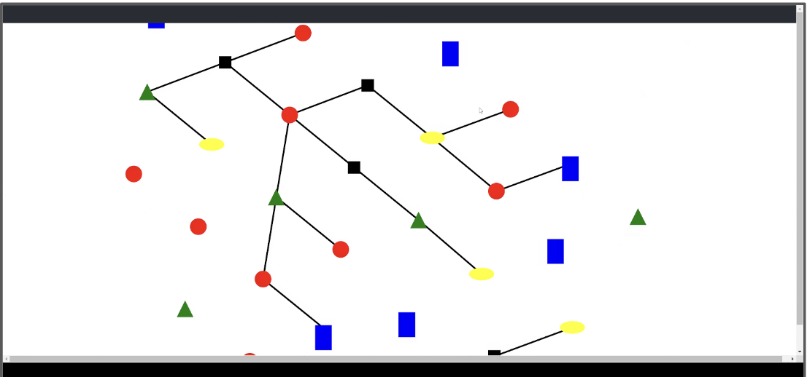
Current Designs
Current Design of the SVG diagrams

Slide 7
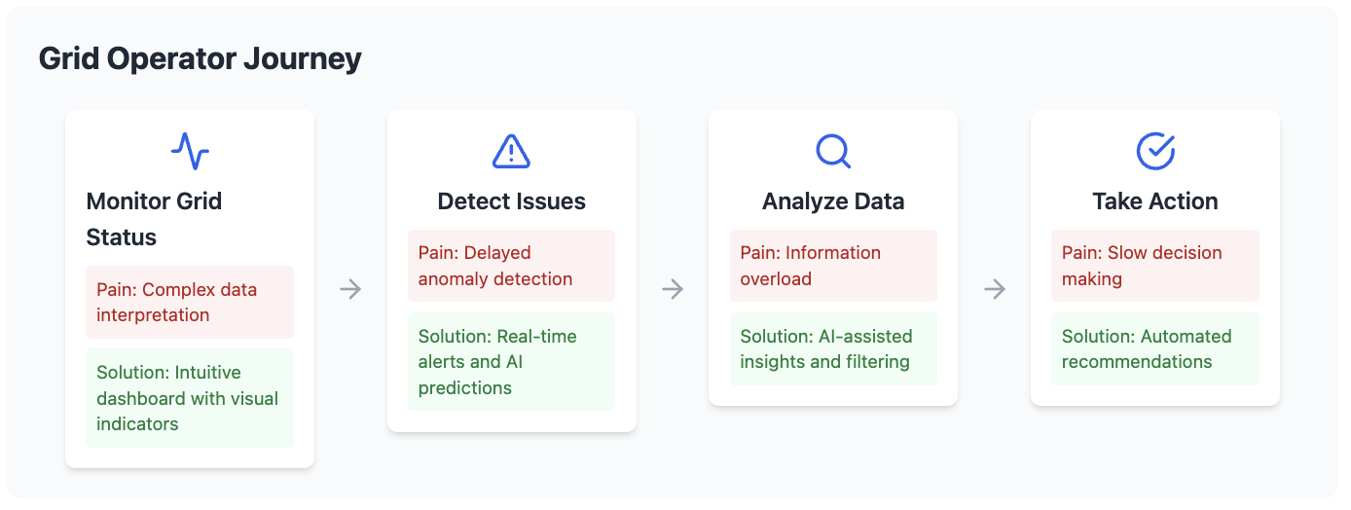
Design Artifacts

Slide 8
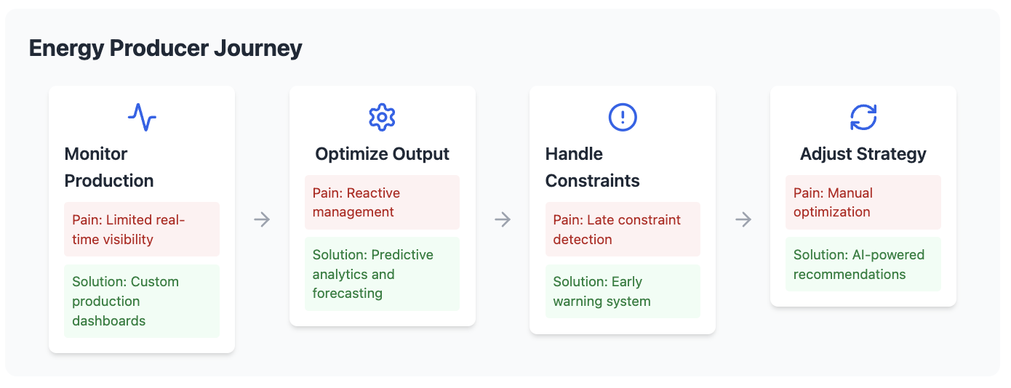
Design Artifacts

Slide 9
Pros/Cons Analysis
Pros
Cons
Modular widget system enables custom workflows
Real-time data processing with WebSocket layer
AI-driven insights for proactive management
Role-based customization
Seamless integration with existing infrastructure
Performance challenges with large datasets
Complex balance of AI automation vs human control
Resource-intensive real-time processing
Learning curve for new users

Slide 10
Technical Complexity Analysis – Integration Points
Firebase authentication
Backend services (Go/Python)
Real-time data streams
AI model integration

Slide 11
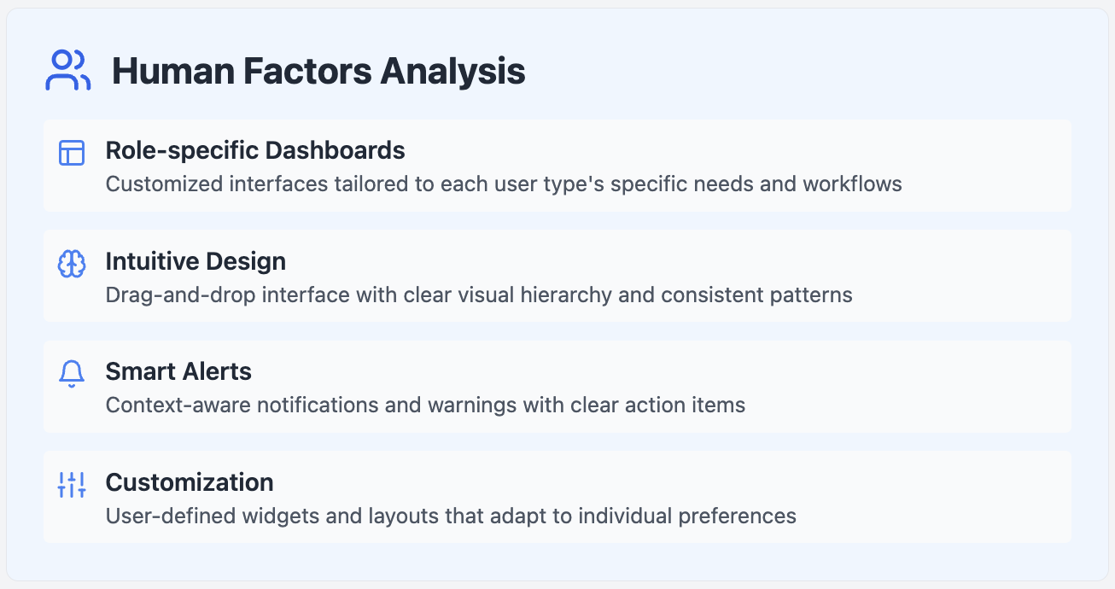
Artifacts: Human Factors
Current solution addresses user needs through:
Role-specific dashboards
Intuitive drag-and-drop interface
Clear visual alerts
Customizable widgets
Proposed improvements:
Enhanced onboarding process
More granular customization options
Improved collaborative features
Simplified AI interaction interface

Slide 12
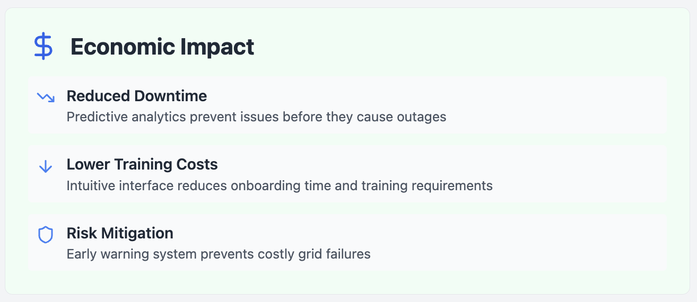
Artifacts: Economic Impact
Improvements over existing solutions:
Reduced downtime through predictive analytics
More efficient resource allocation
Faster decision making
Lower training costs due to intuitive interface
Drawbacks and mitigations:
Higher initial setup costs → Offset by operational savings
Resource-intensive processing → Implementing efficient caching
Complex deployment → Providing comprehensive documentation

Slide 13
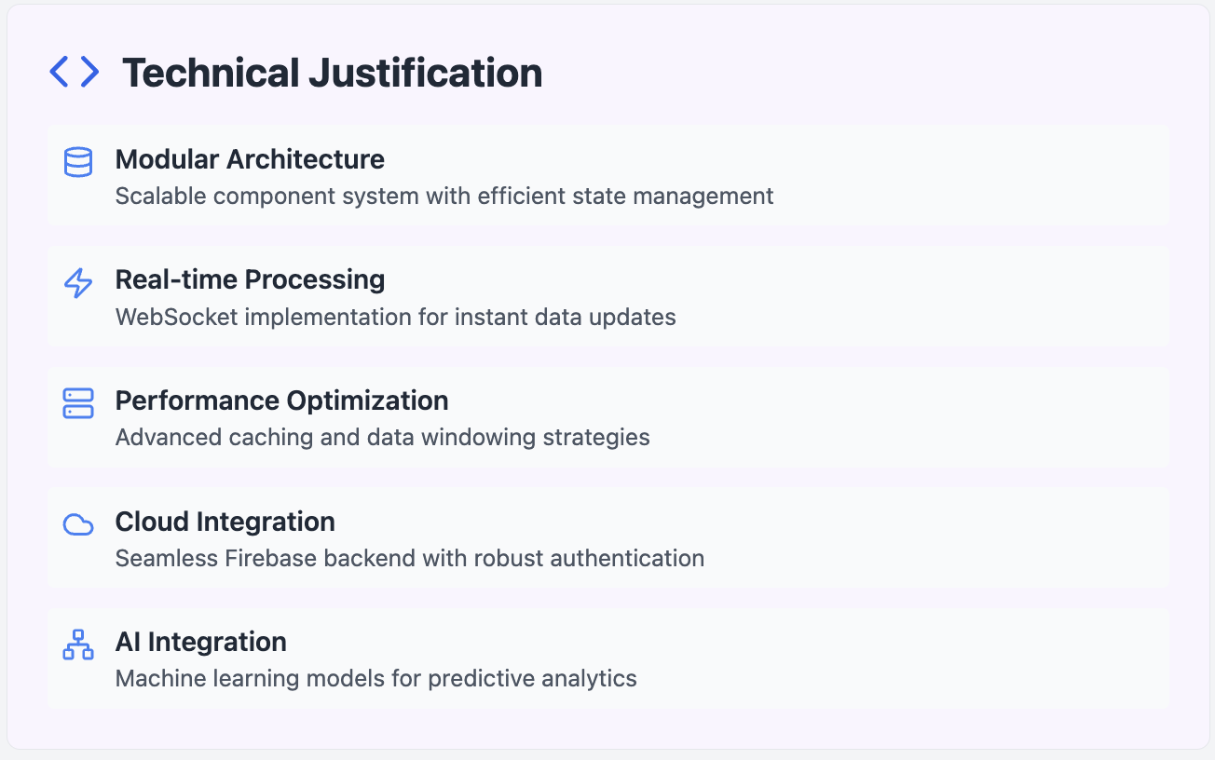
Solutions: Human Factors
Internal complexity:
Modular architecture enables scalability
Advanced state management
Real-time data processing
External complexity:
Industry-standard technologies
RESTful API design
WebSocket implementation
Responsive UI/UX
The design showcases expertise in:
Modern web development
Real-time data visualization
Performance optimization
AI/ML implementation

Slide 14
Conclusion
GridAI's design successfully balances user needs with technical innovation, creating an intuitive interface for complex power grid management. Our modular approach ensures that operators can efficiently monitor and control grid operations while reducing cognitive load.
Our commitment to continuous improvement is reflected in our regular user feedback cycles and iterative development process. Each enhancement is carefully validated against real operator needs and technical requirements.

