Slide 1
GridAI
Lightning Talk 5: Detailed Design
Skyler Kutsch Rangsimun Bargman Franck Biyoghe Bi Ndoutoume Jesus Soto Gonzalez Hang Thang Justin Soberano B.

Slide 2
Project Overview
We are developing an AI integrated system to help grid operators and energy producers manage the complex electrical grid more efficiently. This tool will address challenges in handling large datasets and optimizing grid operations through intuitive interfaces and predictive analytics.
Key features of the system include real-time data visualization, predictive fault detection, and automated decision-making support.
The system addresses significant challenges, such as the ability to handle large datasets efficiently and ensuring the reliability and scalability of grid operations.

Slide 3
Detailed Design and Visuals
The widget dashboard employs a modular architecture built on React components, allowing for flexible arrangement and customization of monitoring elements. Each widget is designed as a self-contained unit that can access real-time data streams while maintaining its own state management.
Core visualizations include status indicators, real-time graphs, and alert panels that adapt to different screen sizes through a responsive grid system.
Real-time data processing is handled through a WebSocket layer that maintains constant communication with the backend servers. This architecture enables immediate updates to all widgets while implementing efficient data caching to prevent unnecessary rerenders and optimize performance.

Slide 4
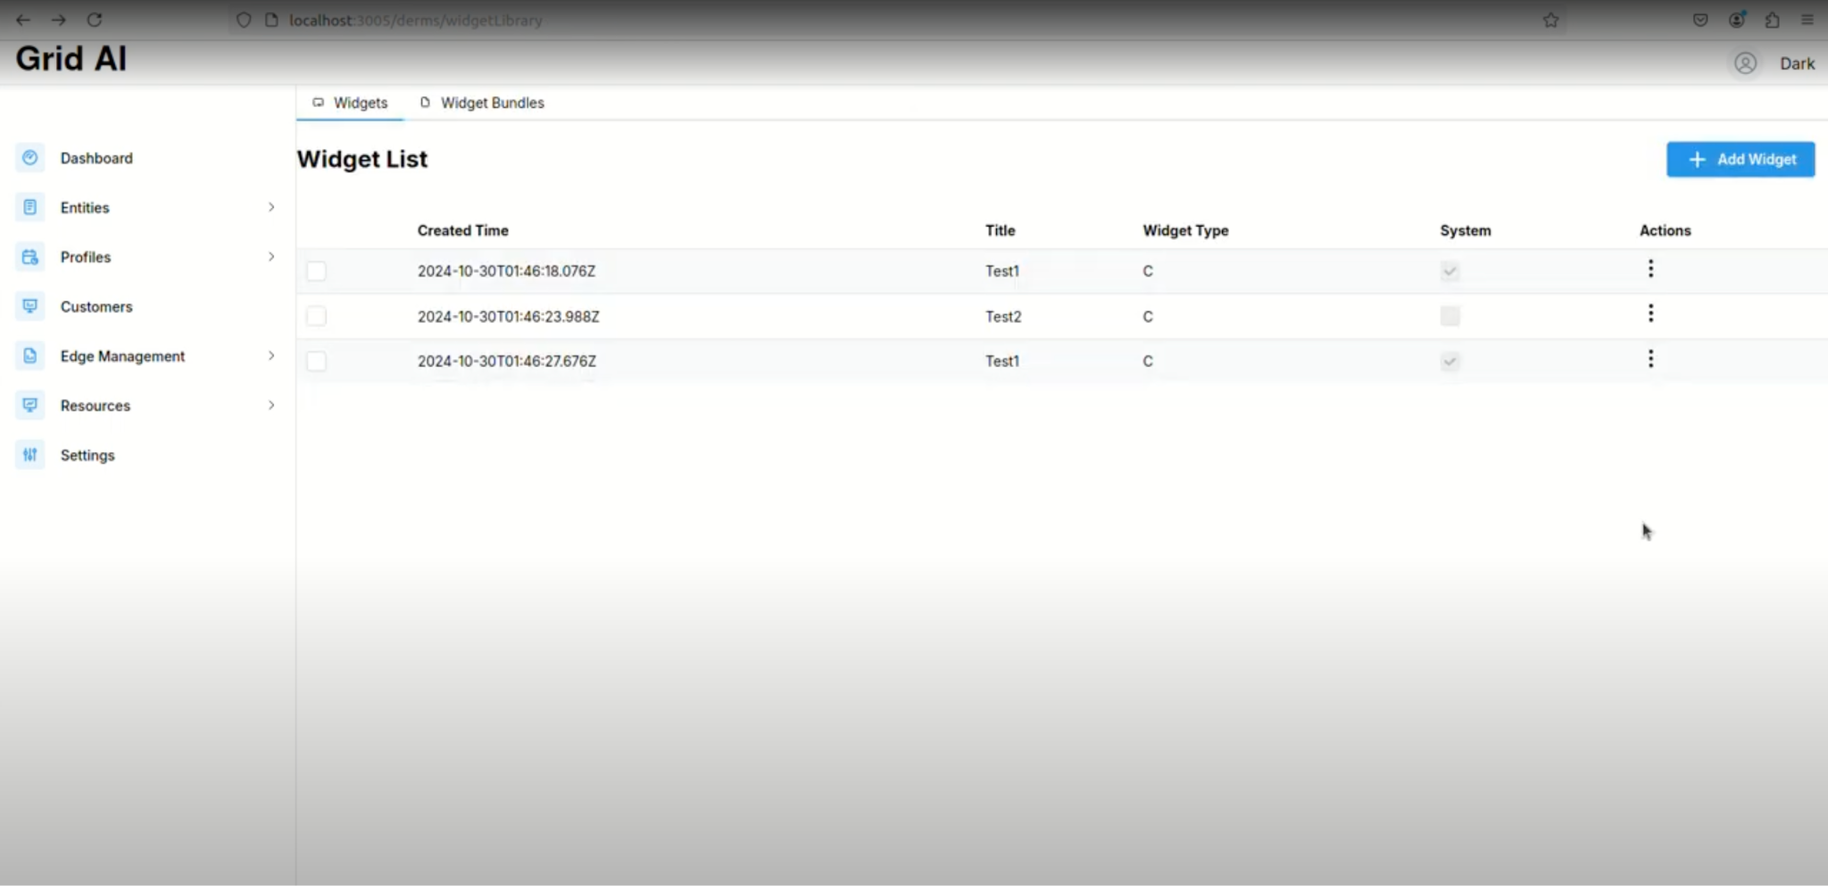
The Widgets Dashboard
Widget List View

Slide 5
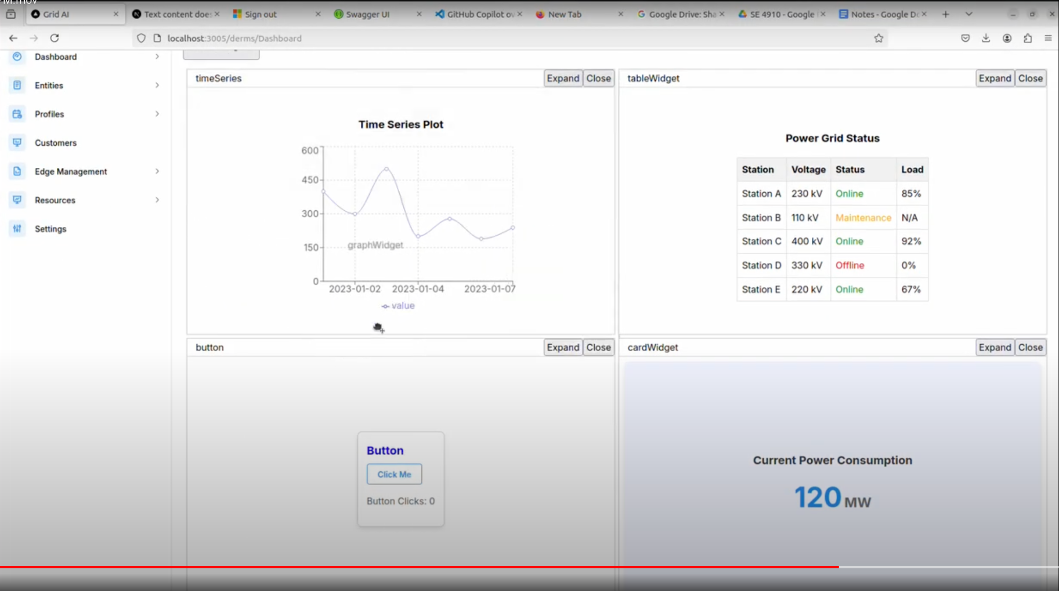
The Widgets Dashboard
Widget Dashboard View

Slide 6
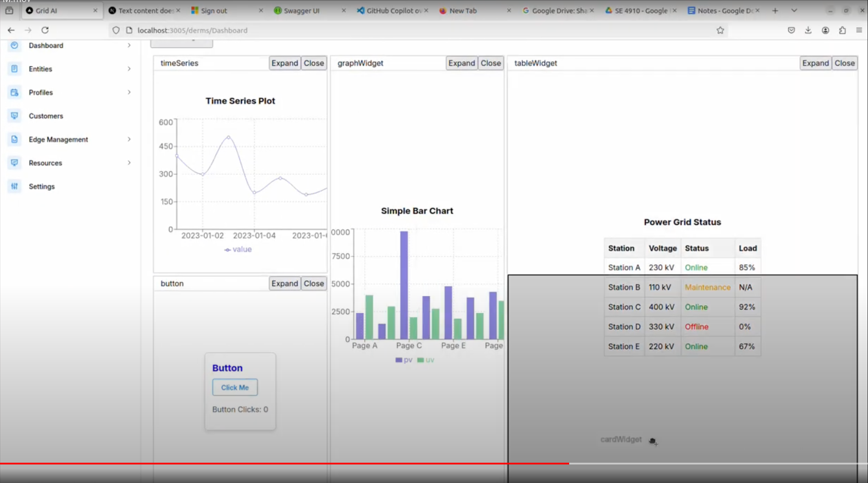
The Widgets Dashboard
Widget Dashboard Customizability View

Slide 7
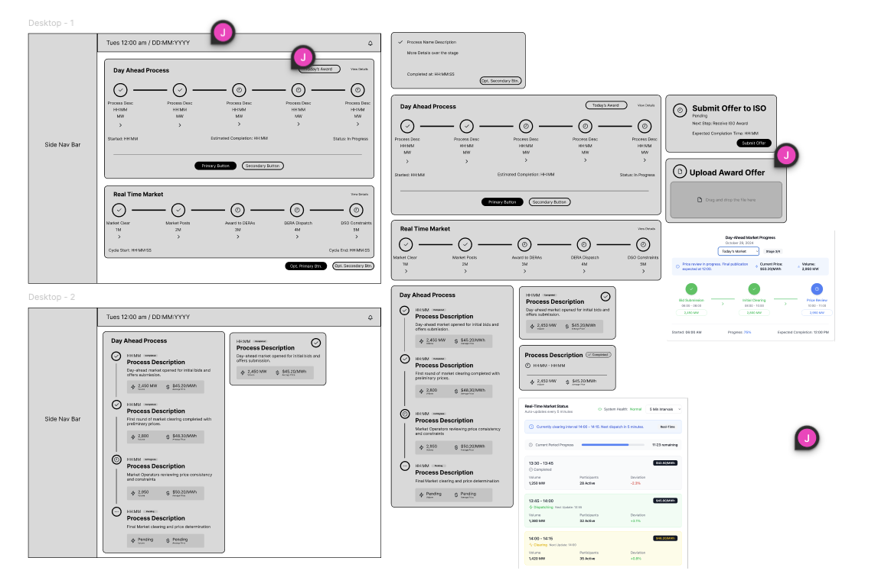
The Widgets Dashboard
Widget Dashboard Wireframes

Slide 8
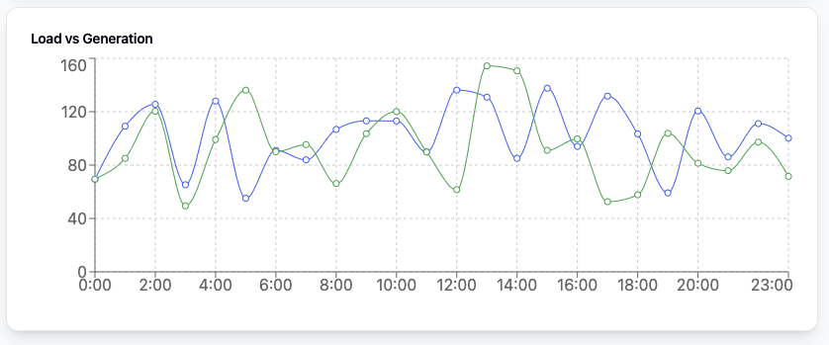
Functionality
Operators interact with a customizable dashboard where they can arrange widgets through drag-and-drop functionality to create role-specific layouts. The system remembers user preferences and automatically restores their preferred configuration upon login.
Real-time monitoring is enhanced by AI-driven insights that appear directly within relevant widgets, providing context-aware suggestions and highlighting potential issues. Interactive charts allow operators to zoom into specific time periods while maintaining an overview of system status through persistent status indicators.
The AI analyzing the data and transforming it into a graph widget.

Slide 9
Technology Considerations
The React-based frontend architecture was chosen over Angular for its component reusability and extensive ecosystem, while potentially sacrificing some built-in structure and tooling. This decision allows for rapid development and easier onboarding of new team members while maintaining code quality through TypeScript integration.
Real-time data visualization is implemented using Recharts over D3.js, trading some customization flexibility for better React integration and performance. The choice enables smoother updates and better handling of real-time data streams while maintaining reasonable bundle sizes.

Slide 10
Areas of Concern and Development
Current widget performance shows occasional lag when handling large datasets, particularly when multiple real-time charts are active. We are implementing data windowing and aggressive caching strategies to address these performance concerns.
The AI integration system requires careful balancing between automated decisions and human oversight, especially in critical operations. We are developing a comprehensive validation system that allows operators to review and override AI suggestions when necessary.
The modular widget system needs further optimization to handle hundreds of simultaneous data points while maintaining responsive performance. Implementing efficient data structures and optimizing render cycles are key priorities for the next development phase.

Slide 11
Conclusion
GridAI's widget dashboard merges modern web technologies with power grid operations into a unified platform. The modular design ensures scalability while maintaining consistent performance.
The integration of AI insights with traditional monitoring gives operators enhanced grid visibility. This combination enables both reactive and predictive approaches to grid management.
Our system simplifies complex grid operations while providing powerful monitoring capabilities. Future development will focus on performance optimization and AI capabilities based on operator feedback.

