Slide 1
GridAI
Lightning Talk 4: Project Planning
Skyler Kutsch Rangsimun Bargman Franck Biyoghe Bi Ndoutoume Jesus Soto Gonzalez Hang Thang Justin Soberano B.

Slide 2
Project Overview
We are developing an AI integrated system to help grid operators and energy producers manage the complex electrical grid more efficiently. This tool will address challenges in handling large datasets and optimizing grid operations through intuitive interfaces and predictive analytics.
Key features of the system include real-time data visualization, predictive fault detection, and automated decision-making support.
The system addresses significant challenges, such as the ability to handle large datasets efficiently and ensuring the reliability and scalability of grid operations.

Slide 3
Project Management Style – Agile
Iterative Development: Agile enables regular iterations, allowing the team to adapt the system based on continuous feedback from grid operators and energy producers.
Flexibility for Complex Data: Agile supports refining real-time data visualization and predictive analytics as the system evolves, ensuring it efficiently handles large datasets.
Cross-functional Collaboration: Agile fosters collaboration between graduate students, backend and front end engineers, and out client to ensuring the system meets both UI/UX and technical needs.

Slide 4
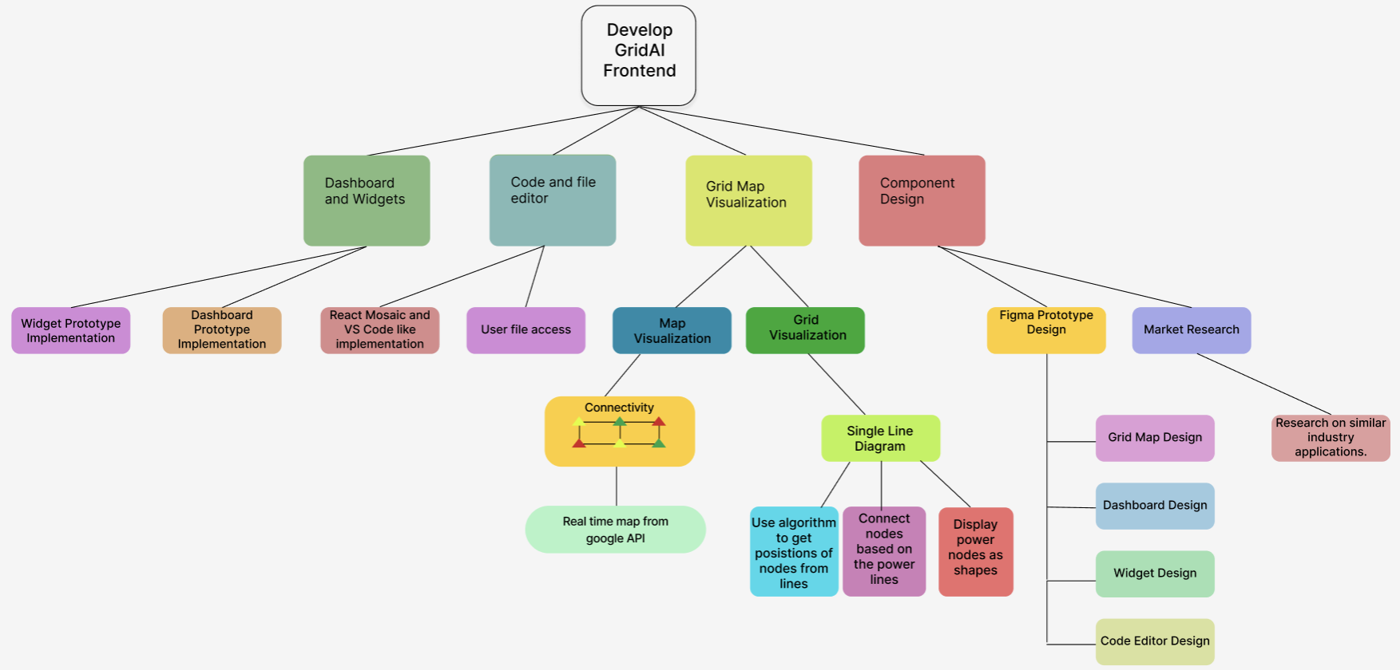
Task Decomposition

Slide 5
Key Milestones
Complete system architecture design and data flow integration.
Develop real-time data visualization dashboards.
Implement predictive fault detection with machine learning models.
Deploy AI-driven automated decision-making tools.

Slide 6
Metrics and Evaluation Criteria
Data processing speed and predictive accuracy of fault detection.
System scalability, reliability, and uptime.
User engagement and interface usability for grid operators.

Slide 7
Key Risk Mitigation
Risk: Data Overload and Latency
Mitigation: Optimize data pipelines and use efficient processing frameworks to handle large datasets in real time.
Risk: Model Prediction Inaccuracy
Mitigation: Continuously train machine learning models with diverse datasets and implement regular validation/testing cycles.
Risk: System Downtime or Failures
Mitigation: Implement redundancy, failover mechanisms, and real-time monitoring for proactive issue resolution.
Risk: User Adoption Challenges
Mitigation: Provide thorough user training and gather feedback to improve the system’s interface and usability.

Slide 8
Conclusion
Agile Development ensures flexibility, continuous improvement, and cross-functional collaboration for delivering a robust AI-integrated system.
Key Features: Real-time data visualization, predictive fault detection, and automated decision-making enhance grid efficiency and reliability.
Milestones & Metrics: Clear objectives focus on system performance, scalability, and user engagement, while key risks are addressed through proactive mitigation strategies.
The system will empower grid operators to manage operations more effectively, ensuring a scalable and reliable solution for future energy demands.

